Slide 1
Metadata Best Practices
Illustrated with the CEDAR Workbench
November 2018
John Graybeal
jgraybeal@stanford.edu

Slide 2
What is the CEDAR Workbench?

Slide 3
A Template Designer to create forms.
A Metadata Editor to fill out those forms.
A Resource Manager to manage the forms and metadata.
Notes:
CEDAR has 3 easy-to-use components: a Template Designer to create forms, a Metadata Editor to fill out those forms, and a Resource Manager to let you manage the forms and metadata.

Slide 4
Terms
Metadata
With semantic services (vocabularies) from BioPortal
And APIs to access metadata remotely or submit them to external repositories
Notes:
What makes CEDAR special as a form creator and metadata collector is that it uses BioPortal to give meaning to the CEDAR values (by connecting them to controlled vocabularies), and provides open API services to allow transferring metadata from CEDAR to public repositories.

Slide 5
Our Best Practices
Quickly target your team’s metadata standards
Make metadata entries consistent and accurate
Enter and verify metadata as quickly and easily as possible
Drive search with well-defined vocabularies and mappings

Slide 6
BP1: Quickly target your team’s metadata standards
Given: A defined standard, community practice, or external requirement for metadata content
Goal: Quickly set up a web service that lets teams enter and verify metadata that meets the specification
Example: Minimal metadata that must meet project requirements and be submitted to an external repository
Approach: Define a metadata form satisfying your metadata content using CEDAR’s Template Builder.
Extra Benefits:
A sharable computable specification in JSON Schema
Support for manual and automated metadata entry.

Slide 7
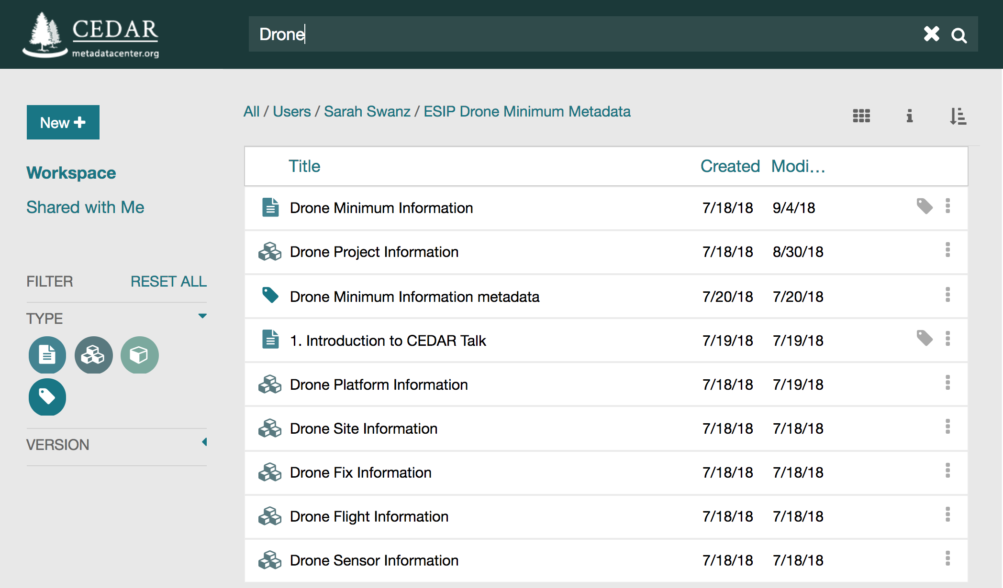
Find a similar template, or create your own
BP1: Target your metadata standards

Slide 8
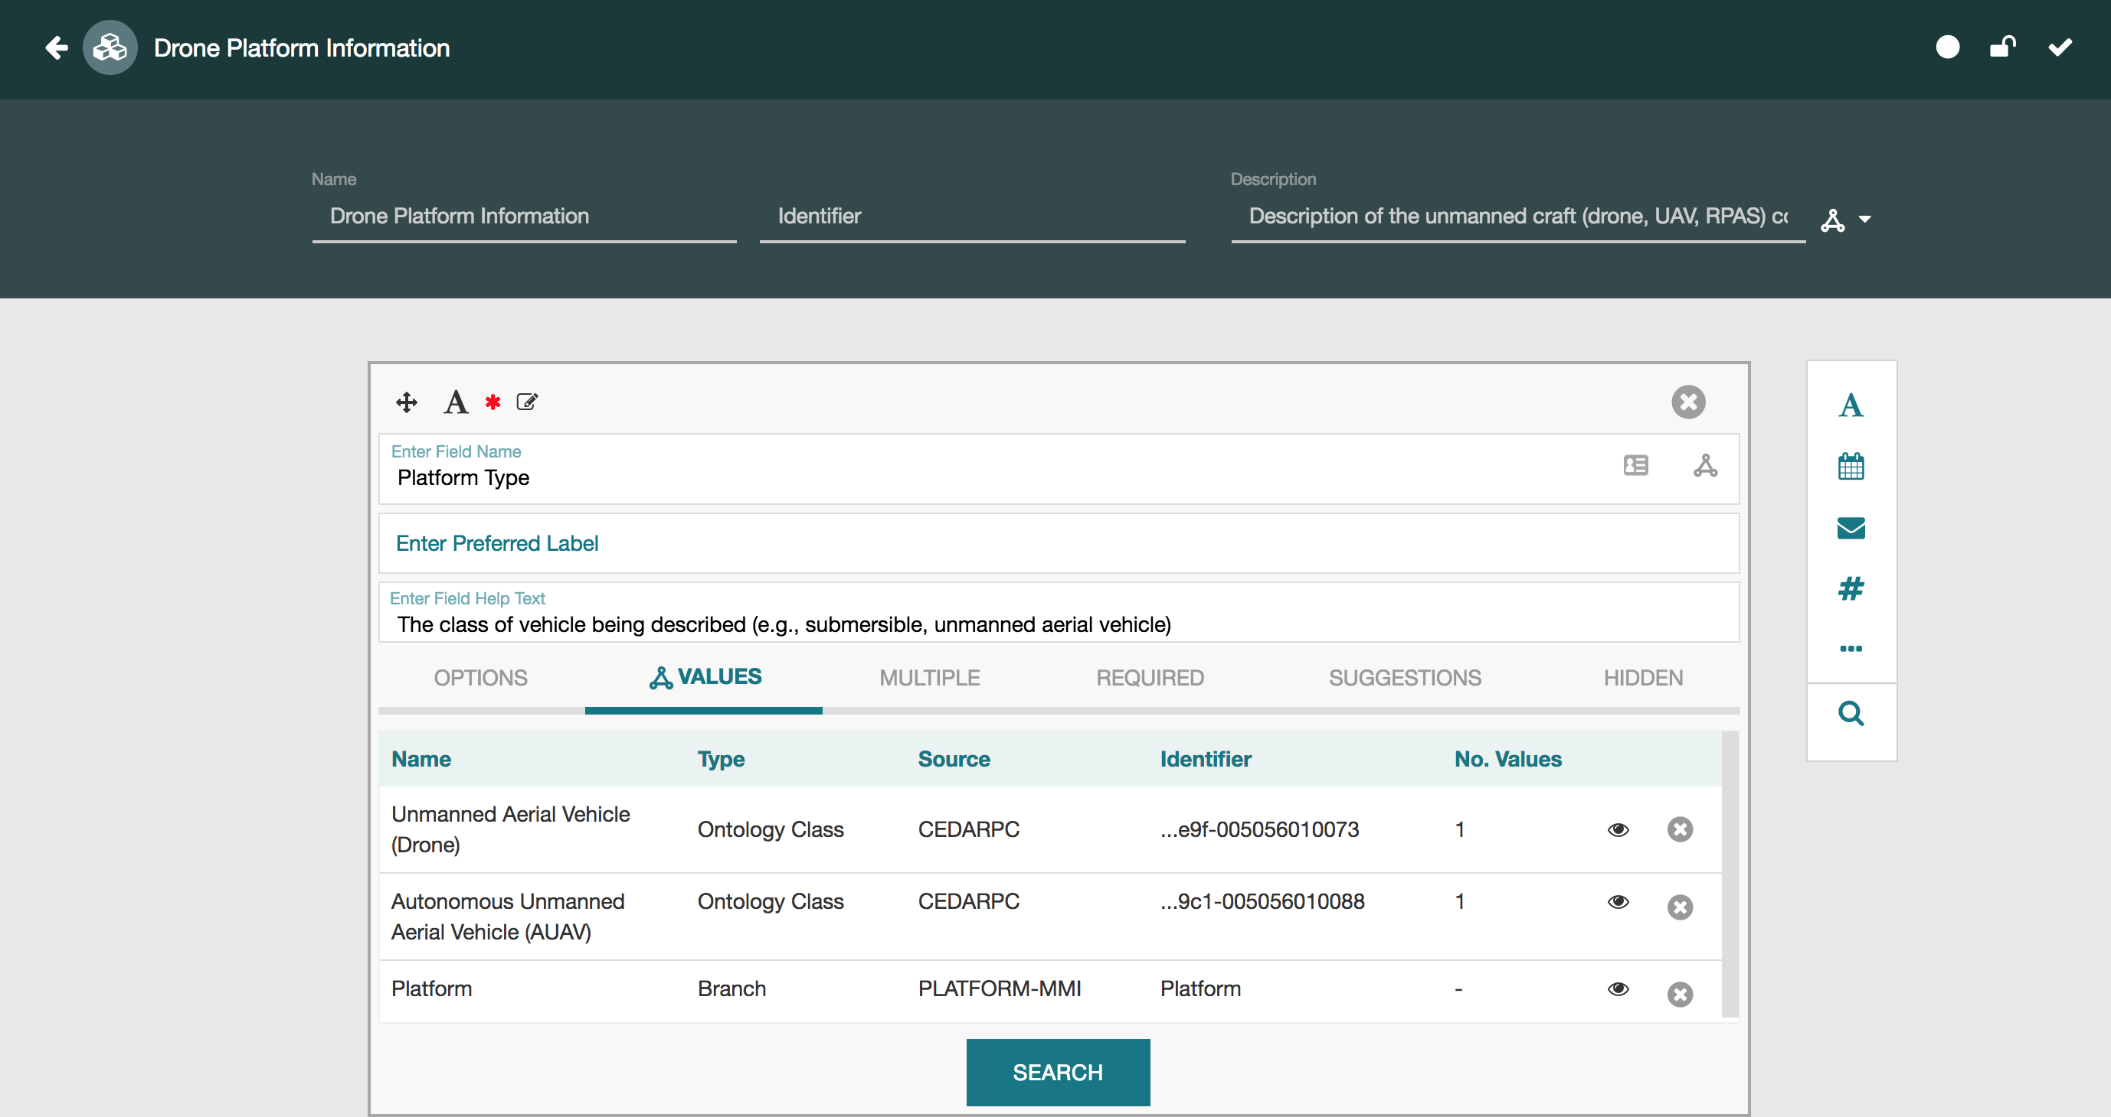
Create fields and elements that match your needs
BP1: Target your metadata standards

Slide 9
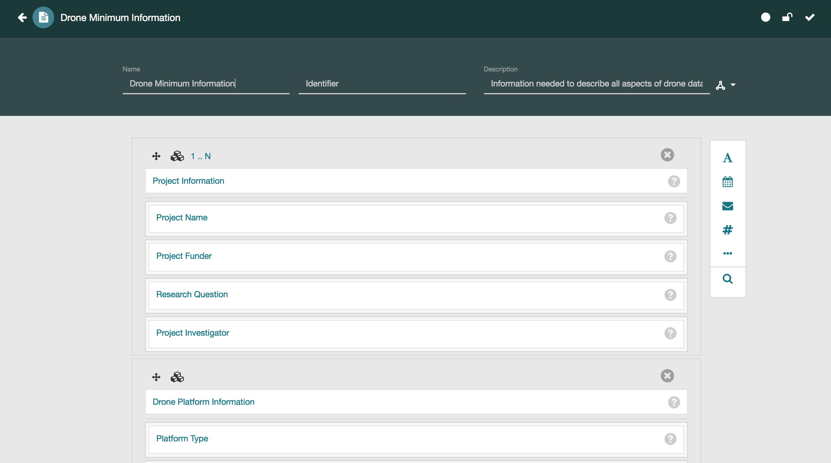
Include fields and elements in your template
BP1: Target your metadata standards
Notes:
Drag fields and elements into the order you want them.

Slide 10
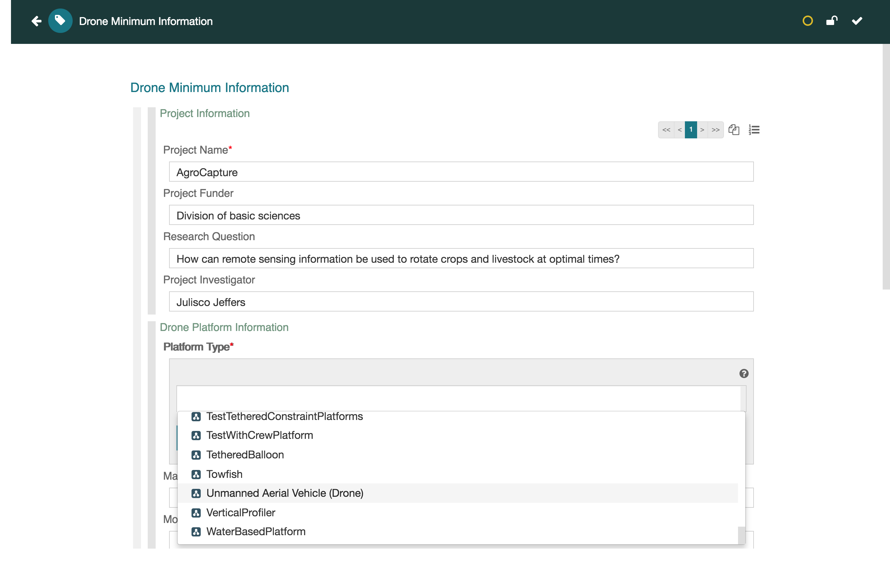
Start collecting your metadata
BP1: Target your metadata standards
Notes:
The metadata is stored in CEDAR, and can be accessed via API or exported to your system.

Slide 11
BP2: Make metadata entries consistent and accurate
Given: Complicated field values that must be exactly right
Goal: Get the metadata entered correctly
Example: Data product descriptions using complex terms
Approach: Semantic Terms from Controlled Vocabularies, Auto-completion, Field Validation, Field Tips
Extra Benefits:
Interoperability with semantic web (JSON-LD or RDF)
Early confirmation of many typographic errors
Less experienced users more confident in their ability to enter good metadata, and more motivated to do so.

Slide 12
BP3: Enter & verify metadata as quickly and easily as possible
Given: Many assets requiring a lot of metadata entries
Goal: Enter metadata quickly with minimal pain
Example: Describe 40 similar files using complex values
Approach: Ordered Controlled Terms, Suggestions, and an ‘Instance example’ (with Hidden fields)
Extra Benefits:
Obtain benefit from earlier work by other contributors
Ability to blend automated, manual metadata entry
Can include ‘provenance fields’ in each filled-out form

Slide 13
BP4: Drive search with well-defined vocabularies and mappings
Given: Metadata from varied sources using terms relatable to other terms (e.g., synonym or parent/child relations)
Goal: To find all applicable matches across term sets
Example: Data in Google’s Data Search is indexed with terms from GCMD, CF, and SWEET. Find all data that includes air temperature.
Approach: Make sure that keyword and parameter description fields in CEDAR templates require selection from well-known controlled vocabularies (or vocabularies mapped to them).
Extra Benefits:
Meaning of concepts in metadata sources is defined.
Value of vocabularies enhanced by usage and mappings.

Slide 14
CEDAR References
Sign up and use CEDAR: https://cedar.metadatacenter.org
Learn about CEDAR: https://metadatacenter.org
More CEDAR references: https://metadatacenter.org/refs
On GitHub (and social media) at metadatacenter

